Slide 1
Gradient-based learning

Slide 2
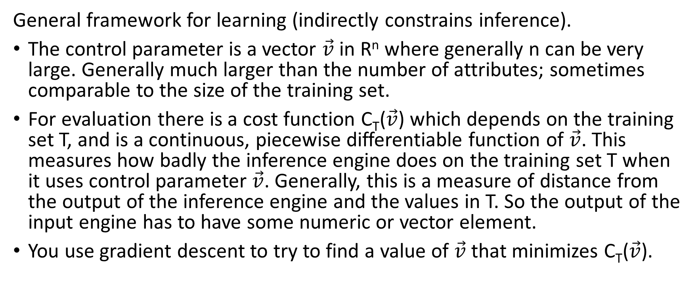
Gradient-descent based learning =
Differentiable learning
General framework for learning (indirectly constrains inference).
The control parameter is a vector $\vec{v}$ in R^{n} where generally n can be very large. Generally much larger than the number of attributes; sometimes comparable to the size of the training set.
For evaluation there is a cost function C_{T}($\vec{v}$) which depends on the training set T, and is a continuous, piecewise differentiable function of $\vec{v}$. This measures how badly the inference engine does on the training set T when it uses control parameter $\vec{v}$. Generally, this is a measure of distance from the output of the inference engine and the values in T. So the output of the input engine has to have some numeric or vector element.
You use gradient descent to try to find a value of $\vec{v}$ that minimizes C_{T}($\vec{v}$).

Slide 3
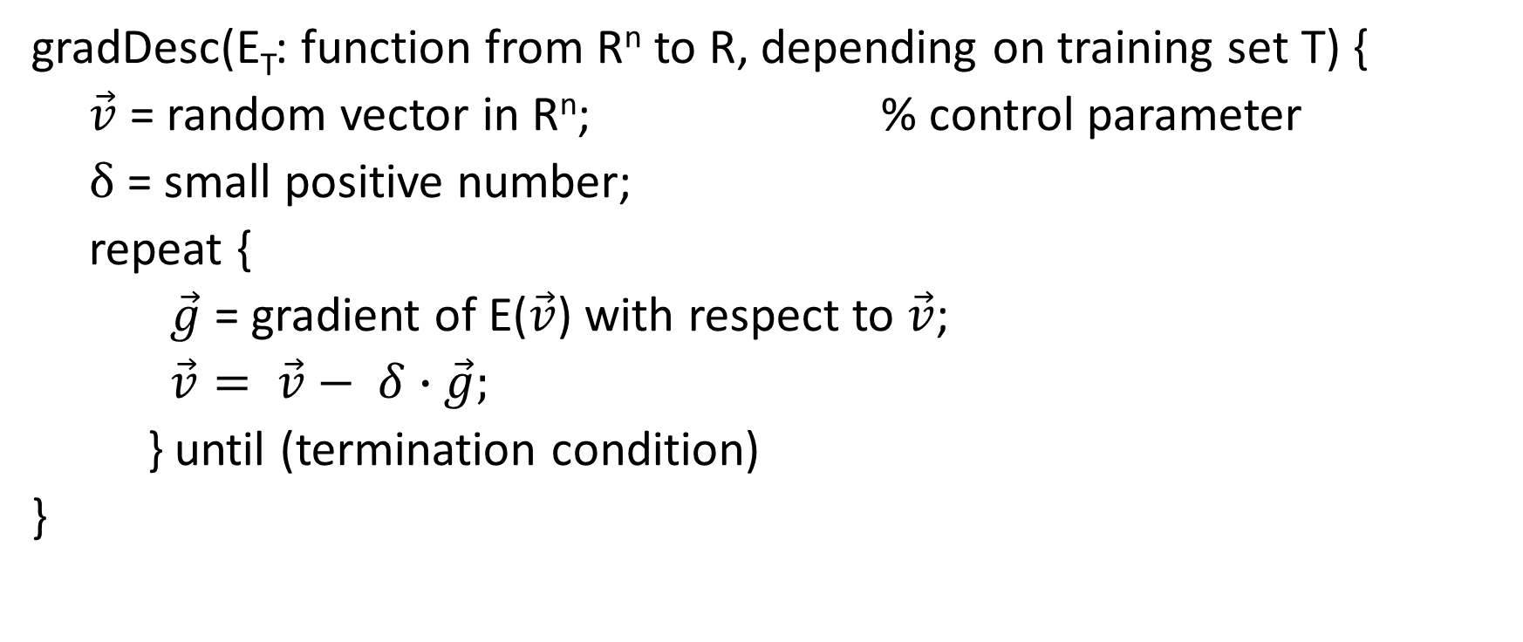
Gradient descent learning algorithm
gradDesc(E_{T}: function from R^{n} to R, depending on training set T) {
$\vec{v}$ = random vector in R^{n}; % control parameter
δ = small positive number;
repeat {
$\vec{g}$ = gradient of E($\vec{v}$) with respect to $\vec{v}$;
$\vec{v}= \vec{v}− δ∙\vec{g};$
} until (termination condition)
}

Slide 4
Perceptrons
Inference: Linear classifier for a Boolean category from numerical predictive attributes.
Learning: Gradient-descent learning
Frank Rosenblatt (1958). Neuronal model.
  "Later Perceptrons, Dr. Rosenblatt said, will be able to recognize people,
  and call out their names. Printed pages, long hand letters, and even
  speech commands are within its reach. Only one more step of development,
  a difficult step, he said, is needed for the device to hear speech
  in one language and instantly translate it to speech or writing in
  another language." NY Times, July 13, 1958

Slide 5
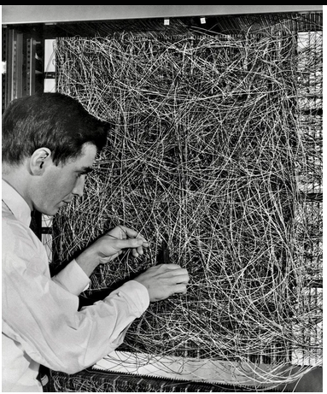
Frank Rosenblatt and the Perceptron (1960)

Slide 6
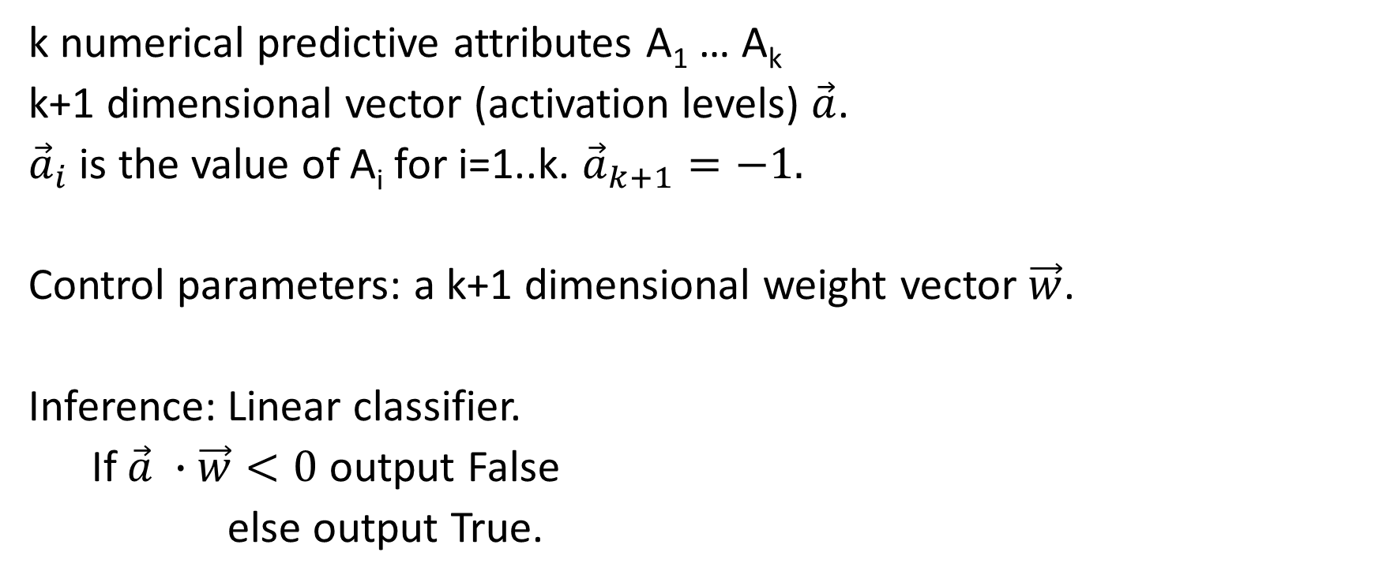
Perceptrons: Inference
k numerical predictive attributes A₁ … A_{k}
k+1 dimensional vector (activation levels) $\vec{a}$.
${\vec{a}}_{i}$ is the value of A_{i} for i=1..k. ${\vec{a}}_{k+1}=−1.$
Control parameters: a k+1 dimensional weight vector $\vec{w}$.
Inference: Linear classifier.
If $\vec{a} ∙\vec{w}<0$ output False
else output True.

Slide 7
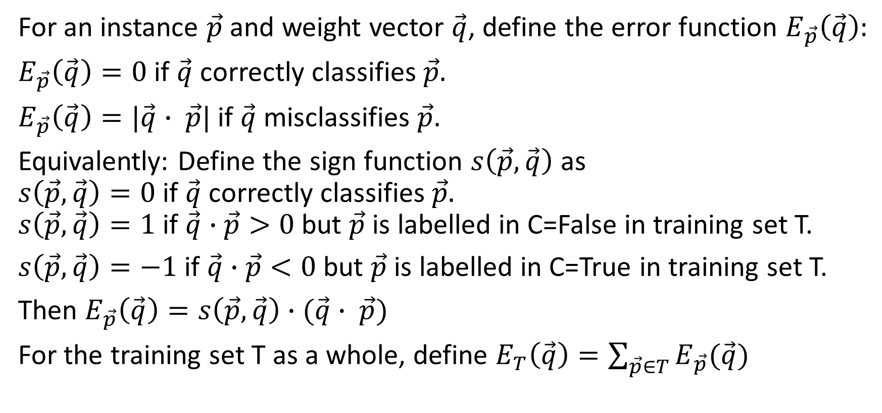
Evaluation function
For an instance $\vec{p}$ and weight vector $\vec{q}$, define the error function $E_{\vec{p}}\left(\vec{q}\right):$
$E_{\vec{p}}\left(\vec{q}\right)=0$ if $\vec{q}$ correctly classifies $\vec{p}.$
$E_{\vec{p}}\left(\vec{q}\right)=|\vec{q}∙ \vec{p}|$ if $\vec{q}$ misclassifies $\vec{p}.$
Equivalently: Define the sign function $s\left(\vec{p},\vec{q}\right)$ as
$s\left(\vec{p},\vec{q}\right)=0$ if $\vec{q}$ correctly classifies $\vec{p}.$
$s\left(\vec{p},\vec{q}\right)=1$ if $\vec{q}∙\vec{p}>0$ but $\vec{p}$ is labelled in C=False in training set T.
$s\left(\vec{p},\vec{q}\right)=−1$ if $\vec{q}∙\vec{p}<0$ but $\vec{p}$ is labelled in C=True in training set T.
Then $E_{\vec{p}}\left(\vec{q}\right)=s\left(\vec{p},\vec{q}\right)∙(\vec{q}∙ \vec{p})$
For the training set T as a whole, define $E_{T}\left(\vec{q}\right)=\sum_{\vec{p}∈T}{E_{\vec{p}}(\vec{q})}$

Slide 8
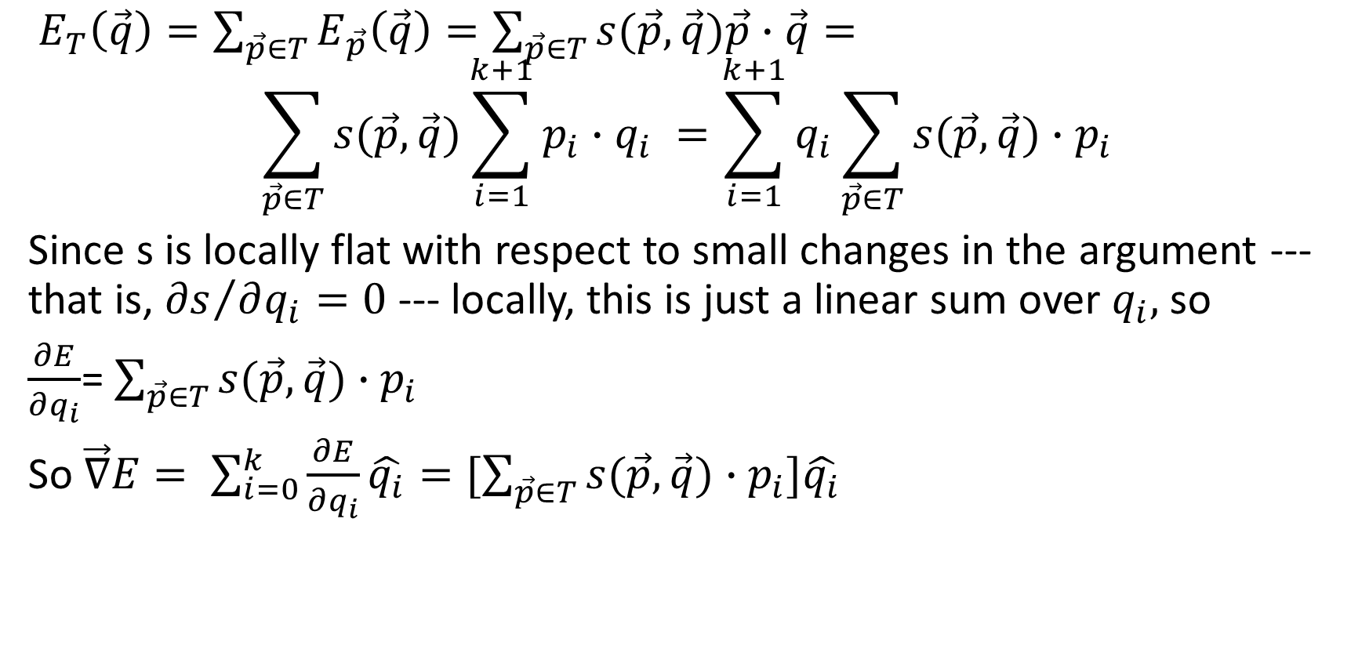
Gradient of the error function
$E_{T}\left(\vec{q}\right)=\sum_{\vec{p}∈T}{E_{\vec{p}}\left(\vec{q}\right)=\sum_{\vec{p}∈T}{s(\vec{p},\vec{q})\vec{p}∙\vec{q}= }}$
$$\sum_{\vec{p}∈T}{s(\vec{p},\vec{q})\sum_{i=1}^{k+1}{p_{i}∙q_{i}} =\sum_{i=1}^{k+1}{q_{i}\sum_{\vec{p}∈T}{s(\vec{p},\vec{q})∙p_{i}}} }$$
Since s is locally flat with respect to small changes in the argument --- that is, ${∂s}/{∂q_{i}=0}$ --- locally, this is just a linear sum over $q_{i},$so
$\frac{∂E}{∂q_{i}}$= $\sum_{\vec{p}∈T}{s(\vec{p},\vec{q})∙p_{i}}$
So $\vec{∇}E= \sum_{i=0}^{k}{\frac{∂E}{∂q_{i}}\hat{q_{i}}=[\sum_{\vec{p}∈T}{s(\vec{p},\vec{q})∙p_{i}]\hat{q_{i}} }}$

Slide 9
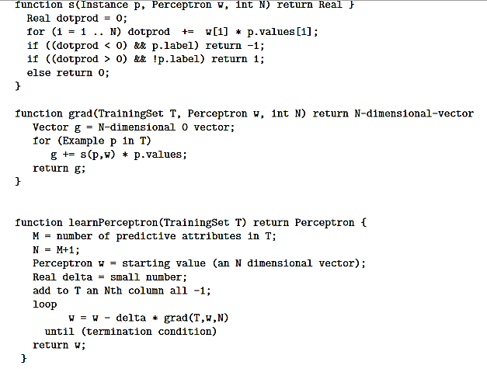
Perceptron training algorithm

Slide 10
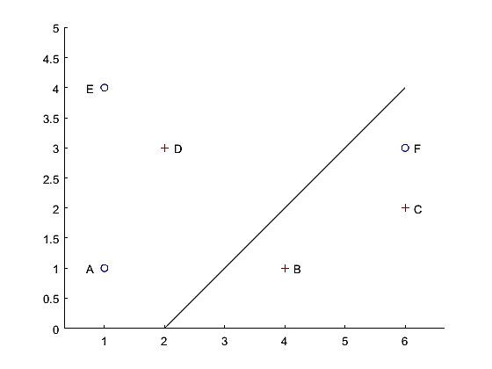
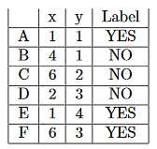
Example
Initial perceptron: -x+y>-2.
A, E, B, C correctly classified
D, F misclassified.

Slide 11
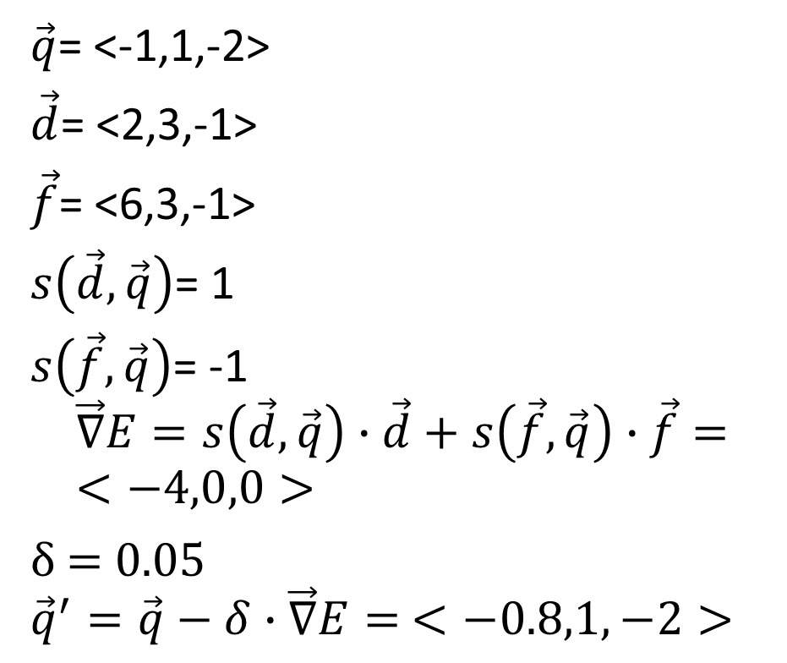
Example
Initial perceptron: -x+y+2>0
A, E, B, C correctly classified
D, F misclassified.
$\vec{q}$= <-1,1,-2>
$\vec{d}$= <2,3,-1>
$\vec{f}$= <6,3,-1>
$s\left(\vec{d},\vec{q}\right)$= 1
$s\left(\vec{f},\vec{q}\right)$= -1
$$\vec{∇}E=s\left(\vec{d},\vec{q}\right)∙\vec{d}+s\left(\vec{f},\vec{q}\right)∙\vec{f}=<−4,0,0>$$
δ = 0.05
$${\vec{q}}^{′}=\vec{q}−δ∙\vec{∇}E= <−0.8,1,−2>$$

Slide 12
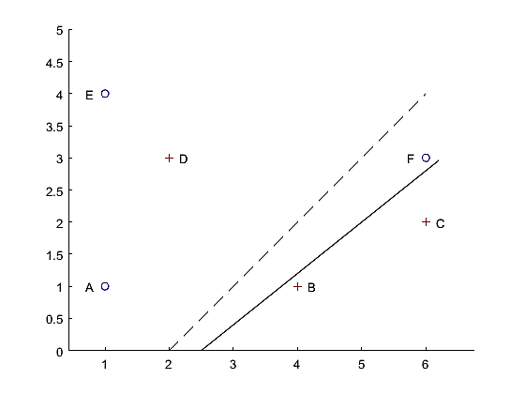
Example
New perceptron: -0.8x + y + 2 > 0
A,B,C,E,F correctly classified
D misclassified.

Slide 13
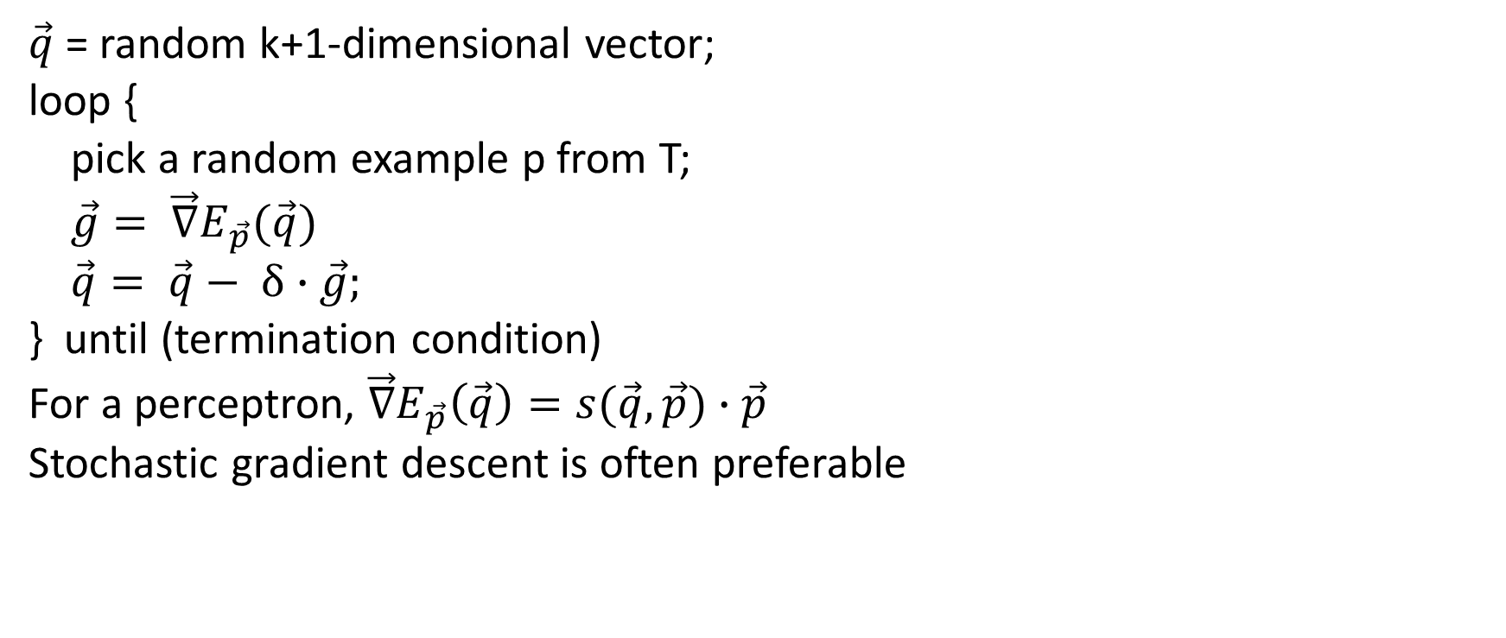
Stochastic gradient descent
$\vec{q}$= random k+1-dimensional vector;
loop {
pick a random example p from T;
$\vec{g}= \vec{∇}E_{\vec{p}}(\vec{q})$
$\vec{q}= \vec{q}− δ∙\vec{g};$
} until (termination condition)
For a perceptron, $\vec{∇}E_{\vec{p}}\left(\vec{q}\right)=s(\vec{q},\vec{p})∙$ $\vec{p}$
Stochastic gradient descent is often preferable

Slide 14
Perceptron theorem
Let S be an infinite sequence of elements in T (with repetitions).
If T is linearly separable, then the stochastic gradient descent algorithm choosing the elements in sequence S will eventually reach a state after which it makes no more mistakes on elements in S.
Independent of the choice of δ.
Elegant, geometric proof in Perceptrons, by Minsky and Papert (not involving gradient descent).

Slide 15
Multilayer neural networks aka Deep Learning
Inference: Simple computational elements, working in parallel and arranged in layers, compute increasingly abstract/semantically meaningful features of the input.
Neuroscientific basis: Hubel and Wiesel (1962) analysis of the visual cortex in cats.

Slide 16
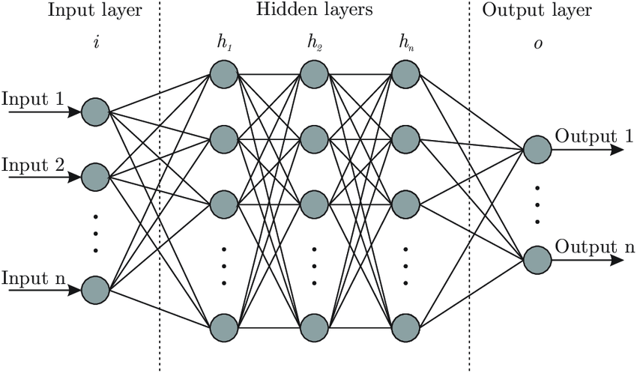
Neural network architecture

Slide 17
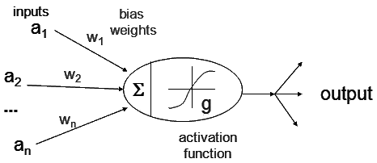
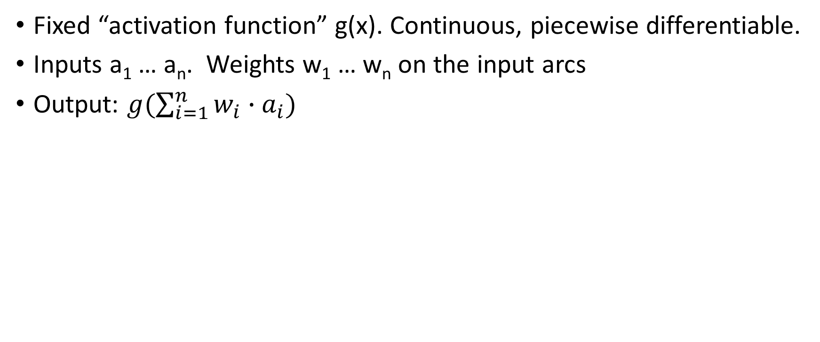
How an element works
Fixed “activation function” g(x). Continuous, piecewise differentiable.
Inputs a₁ … a_{n}. Weights w₁ … w_{n} on the input arcs
Output: $g(\sum_{i=1}^{n}{w_{i}∙a_{i})}$

Slide 18
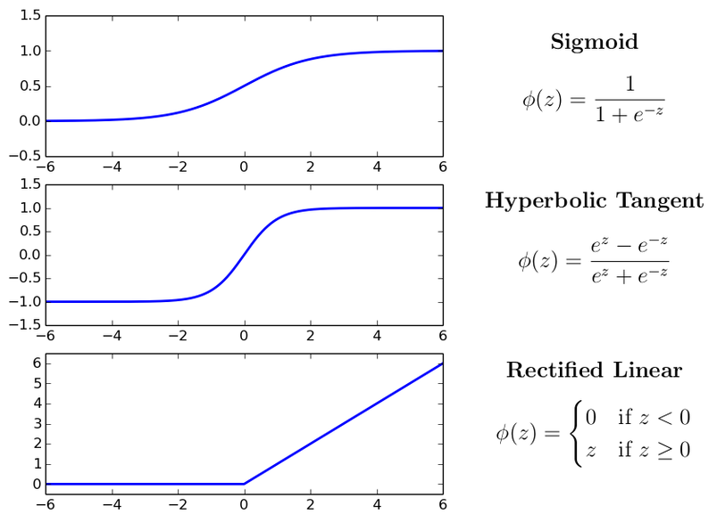
Options for activation function

Slide 19
Non-starters for activation function
Step function, because it is discontinuous and flat everywhere but the step, so no useful gradient.
Linear function, because the composition of linear functions is linear, so nothing is gained by multi-layer systems.

Slide 20
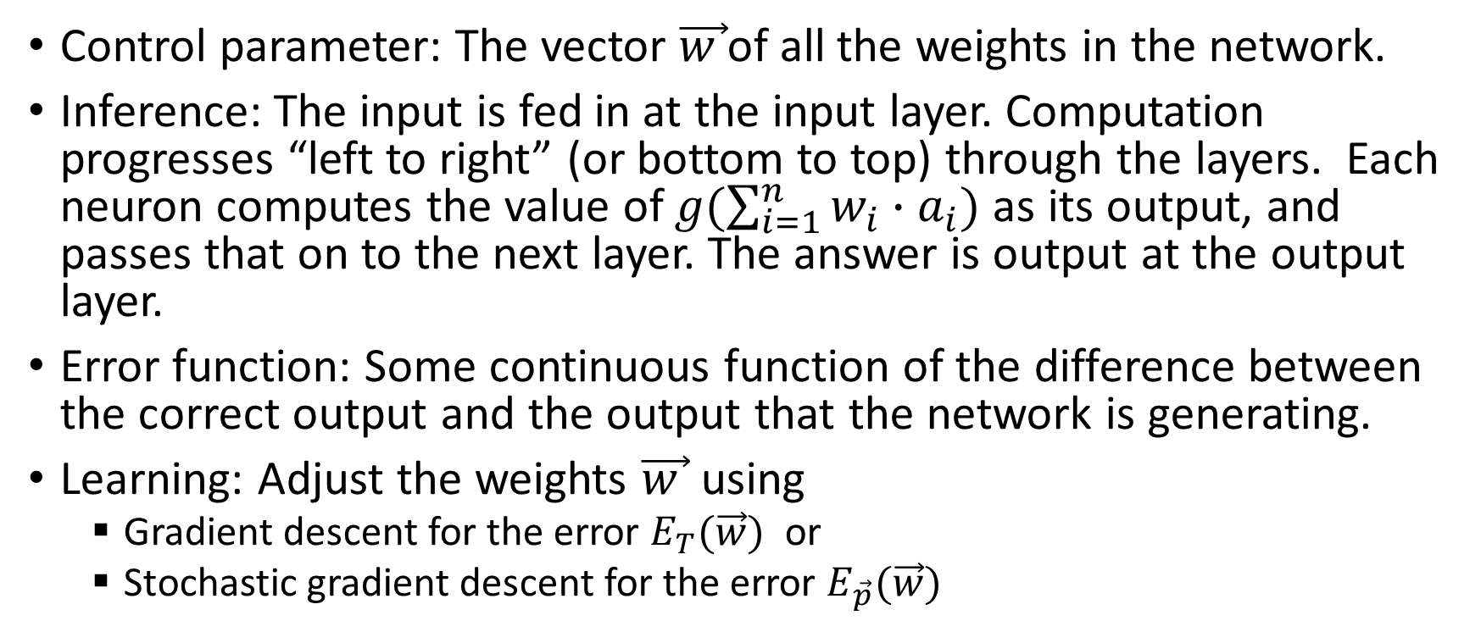
Inference and Learning
Control parameter: The vector $\vec{w }$of all the weights in the network.
Inference: The input is fed in at the input layer. Computation progresses “left to right” (or bottom to top) through the layers. Each neuron computes the value of $g(\sum_{i=1}^{n}{w_{i}∙a_{i})}$ as its output, and passes that on to the next layer. The answer is output at the output layer.
Error function: Some continuous function of the difference between the correct output and the output that the network is generating.
Learning: Adjust the weights $\vec{w }$ using
  Gradient descent for the error $E_{T}(\vec{w})$ or
  Stochastic gradient descent for the error $E_{\vec{p}}(\vec{w})$

Slide 21
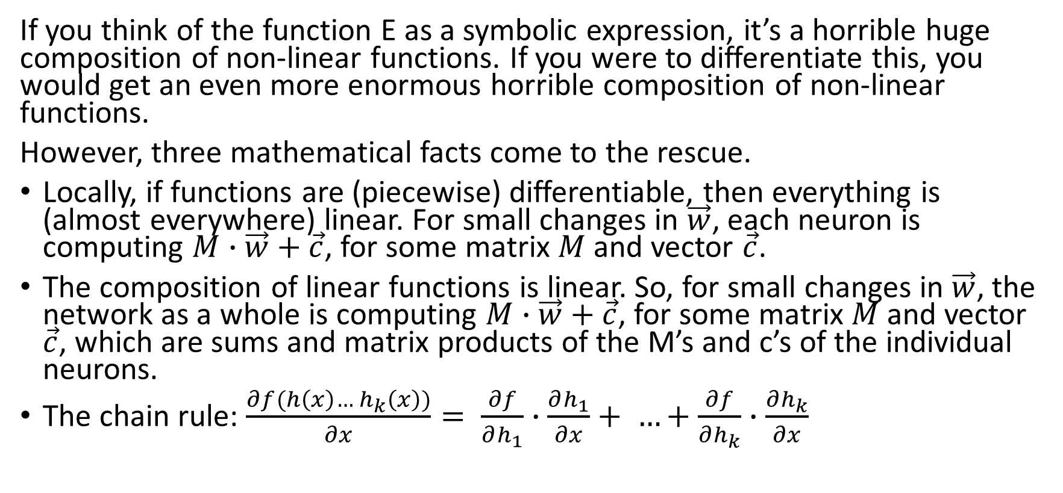

How do you compute the gradient $\vec{∇}E(\vec{w})$?
If you think of the function E as a symbolic expression, it’s a horrible huge composition of non-linear functions. If you were to differentiate this, you would get an even more enormous horrible composition of non-linear functions.
However, three mathematical facts come to the rescue.
Locally, if functions are (piecewise) differentiable, then everything is (almost everywhere) linear. For small changes in $\vec{w}$, each neuron is computing $M∙\vec{w}+\vec{c}$, for some matrix $M$ and vector $\vec{c}$.
The composition of linear functions is linear. So, for small changes in $\vec{w}$, the network as a whole is computing $M∙\vec{w}+\vec{c}$, for some matrix $M$ and vector $\vec{c}$, which are sums and matrix products of the M’s and c’s of the individual neurons.
The chain rule: $\frac{∂f(h\left(x\right)… h_{k}\left(x\right))}{∂x}= \frac{∂f}{∂h_{1}}∙\frac{∂h_{1}}{∂x}+ …+\frac{∂f}{∂h_{k}}∙\frac{∂h_{k}}{∂x}$

Slide 22
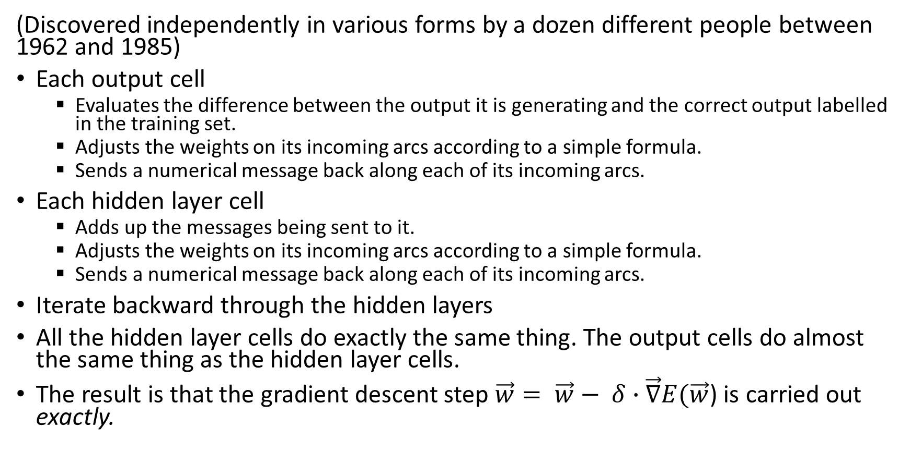
Back propagation algorithm (sketch)
(Discovered independently in various forms by a dozen different people between 1962 and 1985)
Each output cell
  Evaluates the difference between the output it is generating and the correct output labelled in the training set.
  Adjusts the weights on its incoming arcs according to a simple formula.
  Sends a numerical message back along each of its incoming arcs.
Each hidden layer cell
  Adds up the messages being sent to it.
  Adjusts the weights on its incoming arcs according to a simple formula.
  Sends a numerical message back along each of its incoming arcs.
Iterate backward through the hidden layers
All the hidden layer cells do exactly the same thing. The output cells do almost the same thing as the hidden layer cells.
The result is that the gradient descent step $\vec{w}= \vec{w}− δ∙\vec{∇}E(\vec{w}$) is carried out exactly.

Slide 23
Strengths of deep learning
It works! >95% of the successful AI developed in the last decade is powered by deep learning in whole or part.
Very general approach. Can be (and has been) applied to huge range of problems, though these require a range of different architectures.
Requires no domain theory, just data.
Highly parallelizable. Great fit for GPUs.
Inference is somewhat similar to actual neuronal systems. (Backprop is not, as far as anyone knows.)
You can sometimes find interpretable features in the hidden layers.
7-1,000,000: It works!

Slide 24
Overfitting
With immense numbers of parameters, overfitting is an obvious concern.
Early versions of neural networks were extremely prone to overfitting. A common technique was to prematurely stop the gradient descent process.
It’s still an issue, but various techniques have been found to avoid it.

Slide 25
Limitations, difficulties, weaknesses of DL
Data hungry. Generally, large data sets are required.
Computation hungry. Many passes through the training set (epochs) and huge arrays of GPUs are required.
Susceptible to overfitting (discussed later).
Hard to incorporate domain knowledge. If the problem has symmetries, you can sometimes build those into the architecture (e.g. convolutional neural network incorporate translation invariance of images). Otherwise, difficult. So in applications where there is a lot that is already known, you end up throwing out all that knowledge.

Slide 26
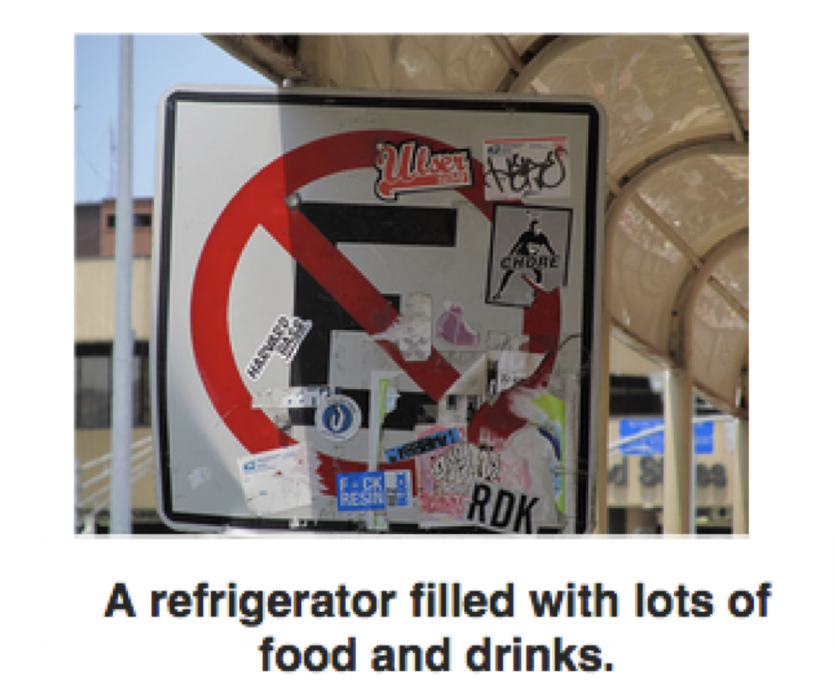
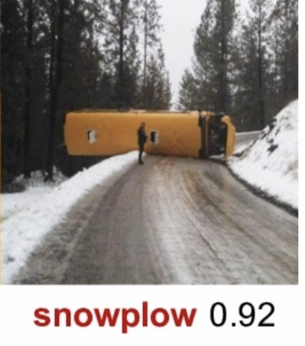

Limitations, difficulties, weaknesses of DL
Focus on superficial rather than fundamental features e.g. texture rather than shape.
Adversarial examples
Hallucinations
Captioned “a woman
talking on a cell phone
while sitting on a bench”

Slide 27
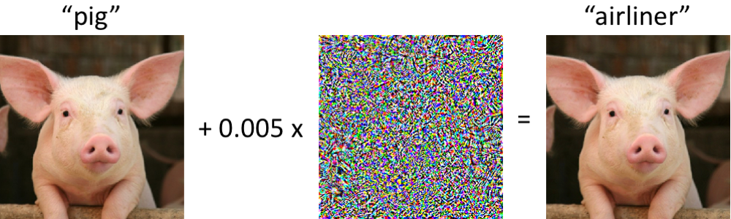
Adversarial example

Slide 28
Limitations, difficulties, weaknesses of DL
Classifier is, in general, opaque.
  Bugs in the classifier cannot be fixed; all you can do is retrain the system.
  Answers cannot be explained.
Not fundamentally understood why DL works as well as it does.

